Slide 1

Distributed Computing
DSBA 6190-U90 | Colby T. Ford, Ph.D.

Slide 2
Overview
Terms
History of Parallel Computing
Containerization and Kubernetes
Intro to Apache Spark

Slide 3
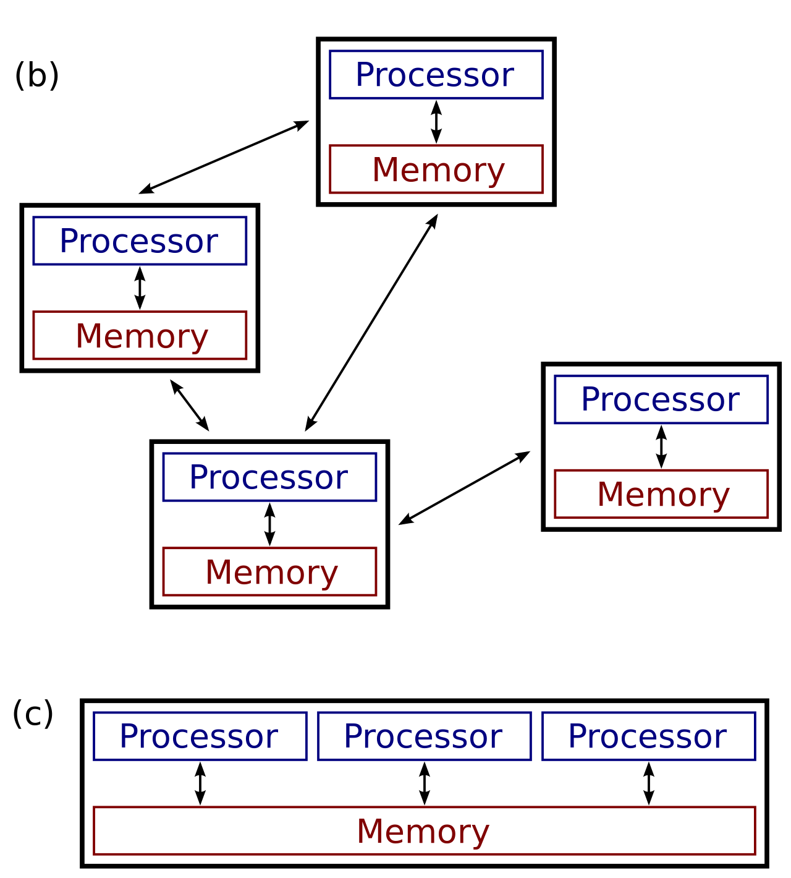
Terms
High Performance Computing
Distributed Computing (b)
Parallel Computing (c)
Using more powerful machines to do computations faster.
Measured in degree of parallelism
Measured in degree of distribution and parallelism
Measured in FLOPS
Using multiple cores to do multiple things at once.
Using multiple machines to do multiple things at once.
File:Distributed-parallel.svg. (2014, August 28). Wikimedia Commons, the free media repository. Retrieved 15:47, October 16, 2019 from https://commons.wikimedia.org/w/index.php?title=File:Distributed-parallel.svg&oldid=132972776.

Slide 4


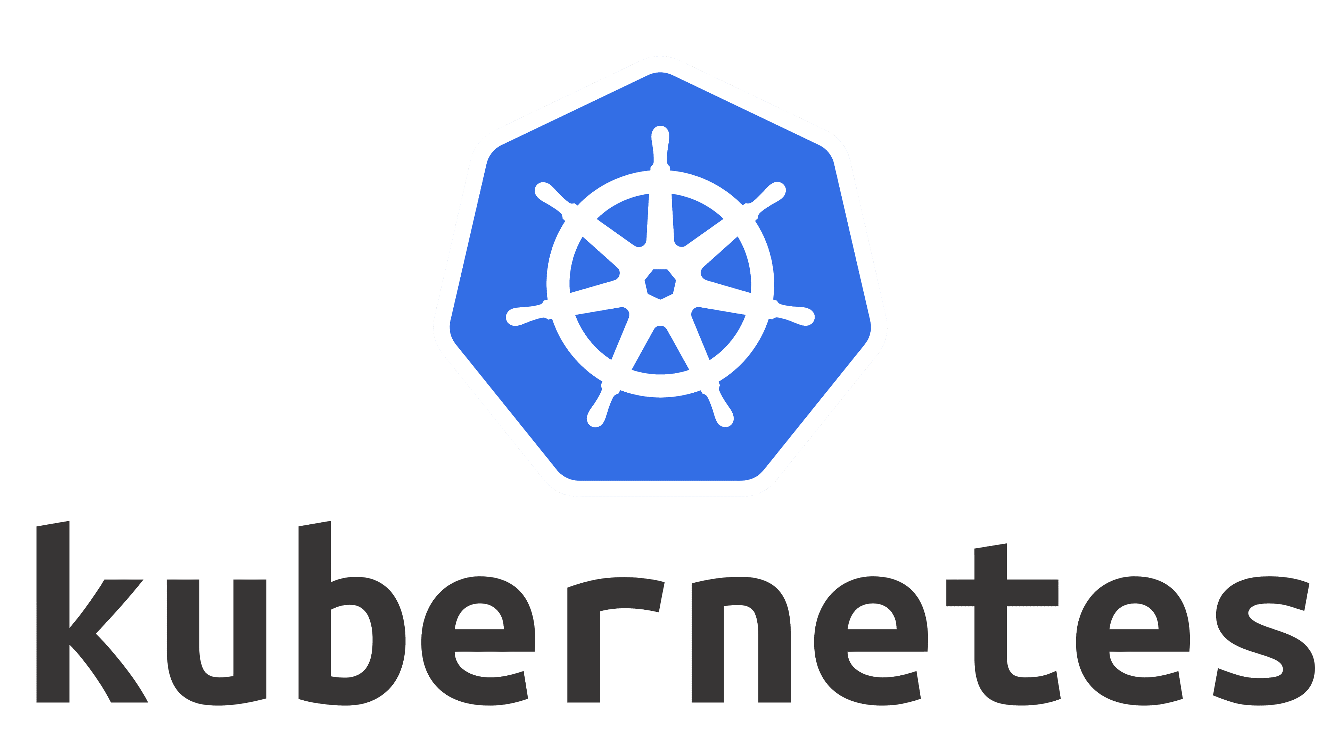
Technology Pipeline
Multicore
MPI
SNOW

Slide 5
Cluster Architecture
Node
Core
Processor
Processor
Core
Task₅
Task₆
Core
Task…
Task_{n}
Core
Node
Processor₁
Core
Task₁
Core
Task₂
Processor
Core
Task₃
Core
Task₄
Cluster

Slide 6
Containerization

Slide 7



Popular Container Frameworks
Most popular, Full-featured
Requires root
Windows, macOS, and Linux
Less popular, More limited
Daemonless and rootless
Windows, macOS, and Linux
Popular on HPC Clusters
Only for Linux
(formerly “Singularity”)

Slide 8

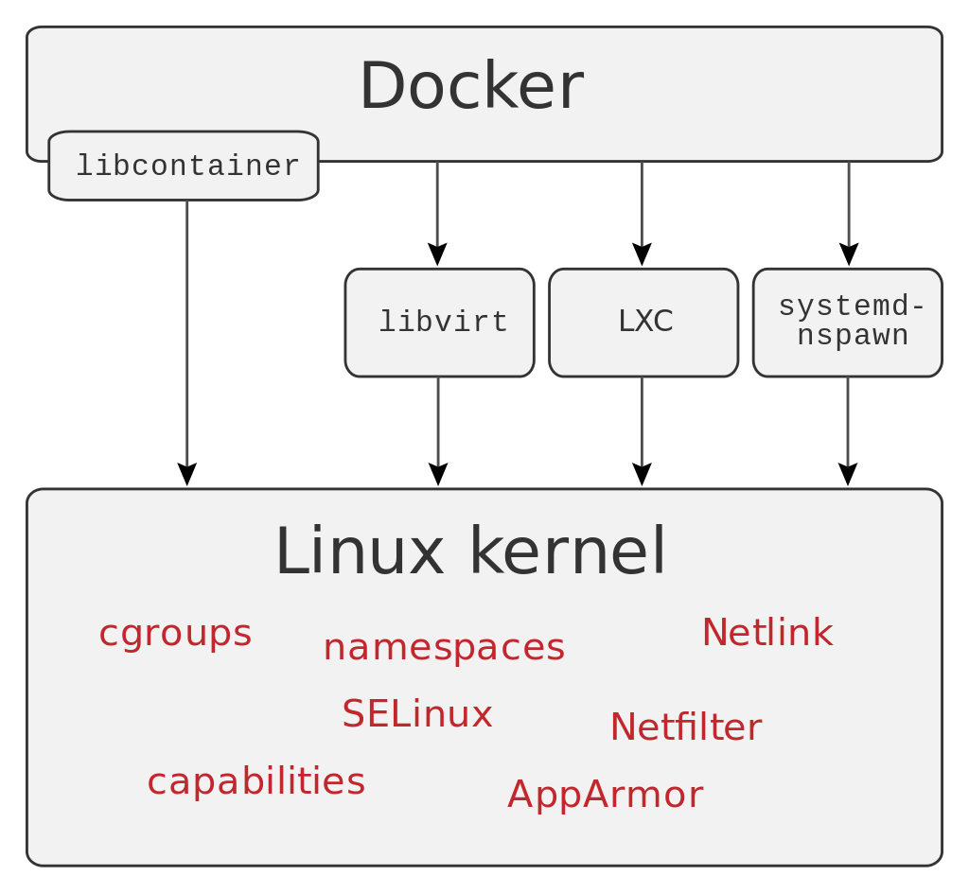
Docker
“Whale, hello there.”
Support for Linux and Windows Server containers (and now WebAssembly).
Flexibility to support microservices and traditional app workloads.
Integrated graphical user interface-based management and operation.
Granular role-based access control, LDAP, and Azure Active Directory integration.
Connection to custom networking and volumes (data storage)
Think of Docker is a trimmed down VM image with sets of packages and settings that are configured for reuse.
Notes:
cgroups – control groups
SELinux – Security Enhances Linux

Slide 9
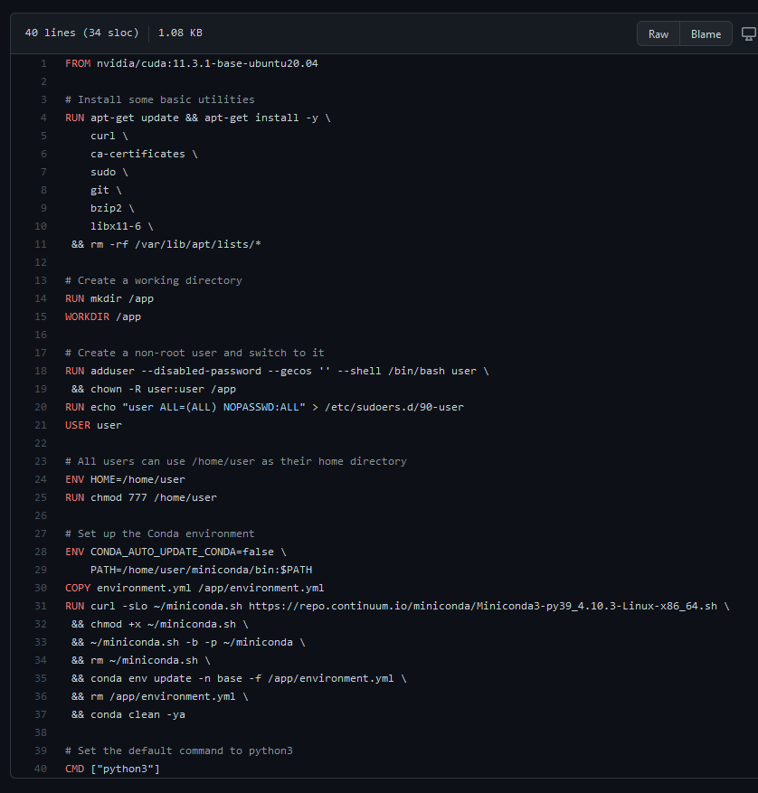

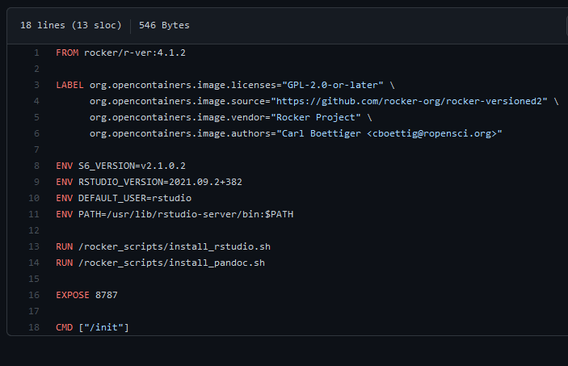

Dockerfile
Contains layers of instructions for configuring the system and installing libraries and files.
Specifies a base layer, which is useful for “picking up where someone left off”

Slide 10
Dockerfile Layers
Base Image
Dependencies
Container Layer
Commands
Entrypoint/Start commands
Ports
FROM ubuntu:latest
apt-get install -y git cmake python3 …
EXPOSE 3000
RUN mkdir /software
RUN rm -r /tmp
ENTRYPOINT ["./run.sh"]
Filesystem, volume(s), etc.
Labels
LABEL maintainer="Colby T. Ford <colby@tuple.xyz>"
CMD ["python", "helloworld.py"]
WORKDIR /software
Environment
ENV key=value
Docker uses layers to save on image space and on build complexity.
Each layer contains the information that changes the layer before it.
When you rebuild, Docker will cache the unchanged layers.

Slide 11
Docker Commands
Get started | Docker Docs
Pull an Image from a Container Registry
docker pull <url>/<user>/<image>:<tag>
docker pull nvidia/cuda:12.6.1-cudnn-devel-ubuntu22.04
docker pull nvcr.io/nvidia/pytorch:22.04-py3
Build an Image Locally
docker build -t <image tag> .
docker build -t reactwebapp .
Run a Container Locally
docker run <image name> <other options>
docker run -p 8888:8888 -v /data/local:/home/jovyan/work jupyter/base-notebook
docker run --name cuda_gpu_1 --gpus all -t nvidia/cuda
Execute Command in a Container
docker run/exec <image name> <commands>
docker run --name mycontainer1 -it mycontainer /bin/bash
docker exec -it mycontainer /bin/bash

Slide 12
Volumes (and sharing other resources)
Host Machine
Docker System
Container
bind mount
tmpfs
mount
veth
Filesystem
Memory
Network
volume
Docker Area
CPUs
GPUs
(shared with host)
nvidia
container toolkit

Slide 13
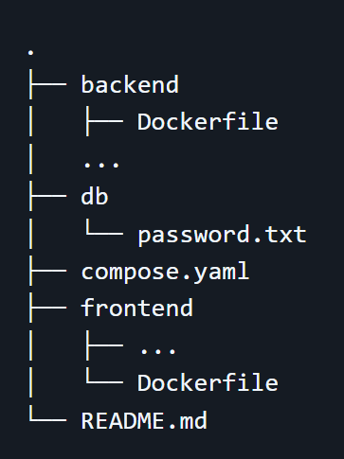
Docker Compose
compose.yaml File
services:
backend:
build: backend
ports:
- 80:80
- 9229:9229
- 9230:9230
...
db:
image: mariadb:10.6.4-focal
...
frontend:
build: frontend
ports:
- 3000:3000
...
Docker Compose allows you to specify multiple images that can communicate with one another.
Networking (vNets)
Volumes (databases)
docker compose up -d
docker compose down
Less used in cloud native environments where PaaS options are more common.
Directory Structure

Slide 14

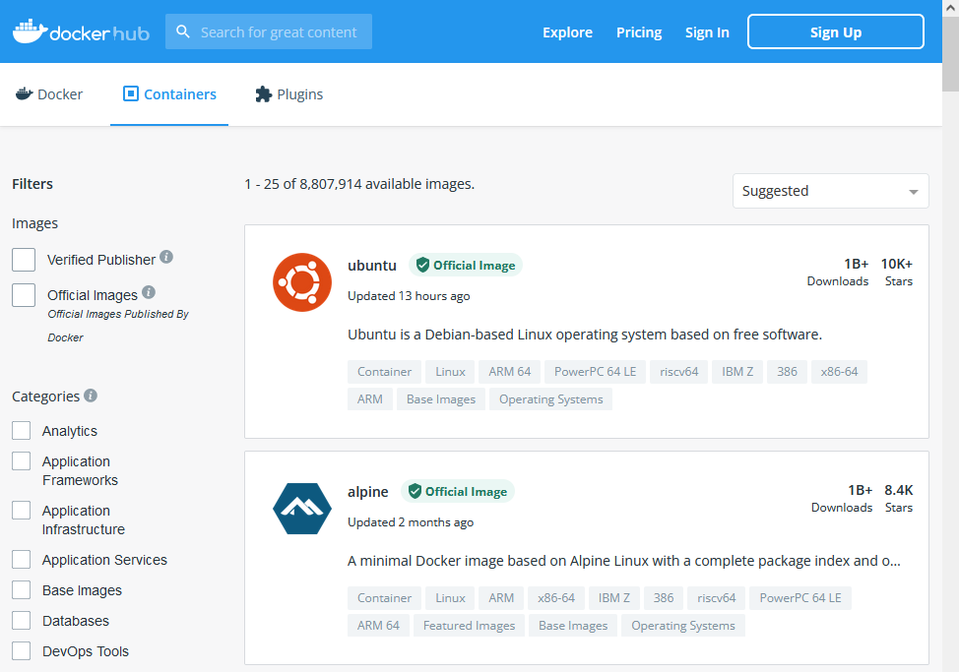
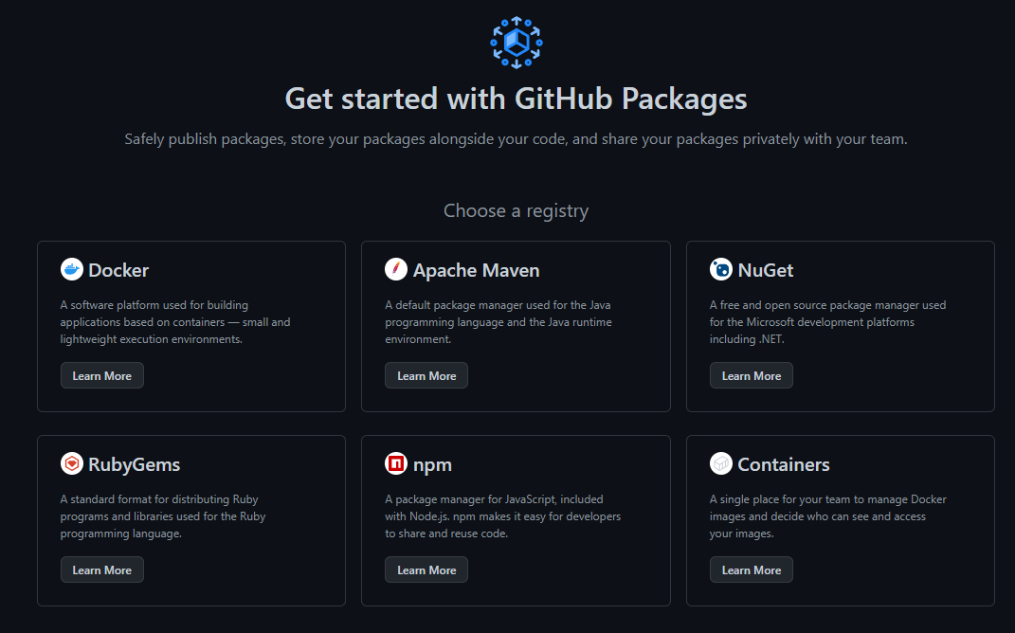
Container Storage
Azure Container Registry
GitHub Packages
DockerHub

Slide 15



Container Usage
Deploy containerized applications to Azure for quick and scalable use.
Pick the Runtime Stack (Node, .NET, Python, etc.) and OS (Linux or Windows)
Pick the size of machine (RAM, CPUs, GPUs)
Azure Web Apps
Azure Container Instances
Azure Kubernetes Service

Slide 16
Container Registry Commands
Login to the Container Registry
az acr login --name <registry name>
az acr login --name crdsba6190deveastus001
Tag the Image with the URL, your name, and tag
docker tag <image name> <registry name>.azurecr.io/<image name>:<tag>
docker tag instructor_sklearn crdsba6190deveastus001.azurecr.io/instructor_sklearn:latest
Push the Image to the Container Registry
docker push <registry name>.azurecr.io/<image name>:<tag>
docker push crdsba6190deveastus001.azurecr.io/instructor_sklearn:latest

Slide 17




Container Orchestration
Once containers are created, use container orchestration to organize, coordinate, and schedule their use.
Useful for scaling containers and making use of distributed environments
Other capabilities:
Security management
API Serving
Resource Monitoring
Load Balancing
https://azure.microsoft.com/en-us/resources/videos/azure-kubernetes-service-overview/

Slide 18
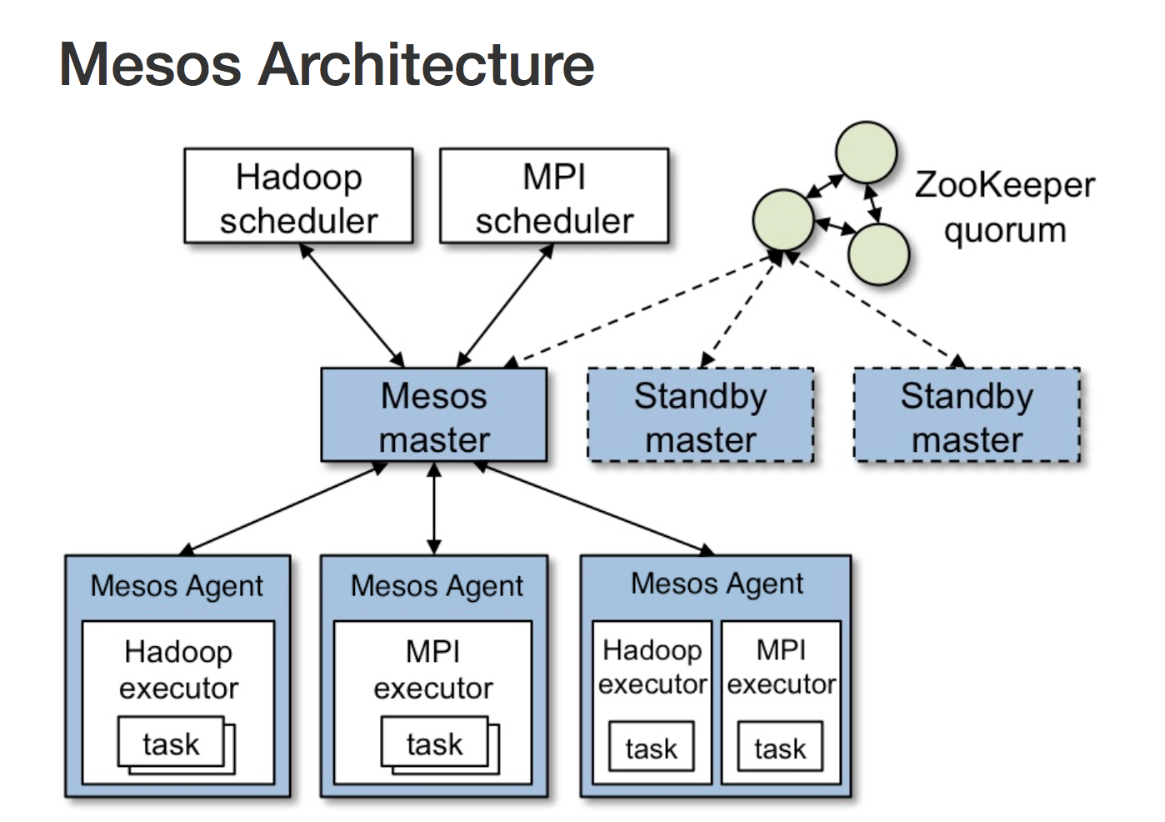
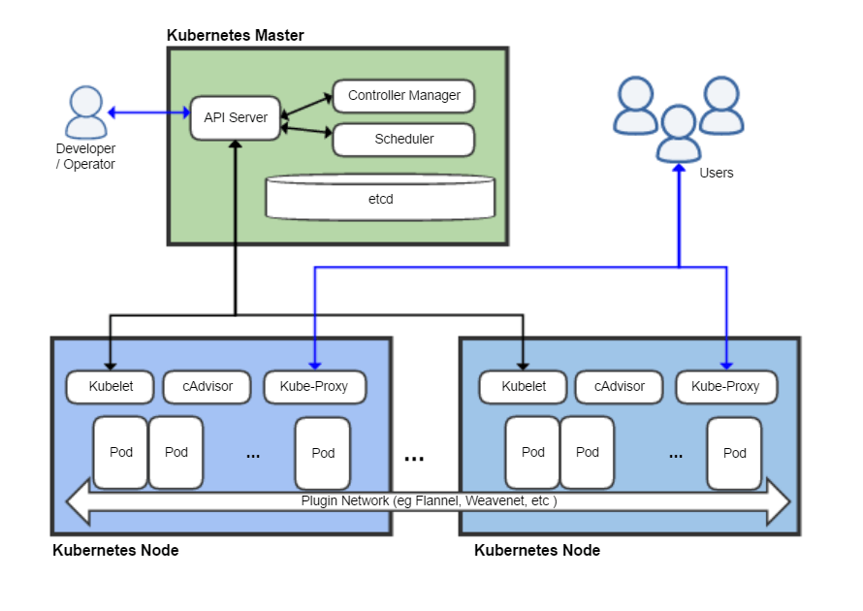

Slide 19
What is / Why Kubernetes?

Slide 20

What is Kubernetes?
Kubernetes (K8s) is an open-source container orchestration system.
Use Docker containers and spin up compute nodes as needed.
Specify different resource needs by node pool.
Memory, CPUs, GPUs
Learn more: https://kubernetes.io/

Slide 21
Why (Cloud) Kubernetes?
K8s can be used for everything from microservices to long-running compute tasks
Not everything in bioinformatics is a pipeline. (Duct taped shell scripts, anyone?)
Not every pipeline has the same needs (GPUs, memory, CPUs, etc.)
Cloud providers have platform services that are fully compatible with open-source K8s
Azure Kubernetes Service (AKS)
AWS Elastic Kubernetes Service (EKS)
Google Kubernetes Engine (GKE)
Take advantage of the “limitless” compute capacity of the cloud + networking and security
Mount your data lake as a Volume in the K8s cluster, making the data available to every container
No copying data around
Get references and input files from /mnt
Write results directly back to the data lake

Slide 22
Basic K8s Cluster Architecture
Cluster
volumes
secrets
config maps
networking
Control Plane
Node Pool₁
tolerations
taints
labels
Node₁
Node_{n}
CRI
CRI
pod
kube-scheduler
pod
…
kubelet
kubelet
pod
kube-proxy
pod
kube-proxy
kube-api-server
…
etcd
Node Pool_{p}
tolerations
taints
labels
Node₁
Node_{n}
CRI
CRI
…
pod
kubelet
pod
kubelet
kube-controller-manager
pod
kube-proxy
kube-proxy
CRI: Container Runtime Interface

Slide 23
Kubernetes + Queue-Based Architecture
Task A Queue
AKS
Control Plane
Provision Pods (or Remove Dead Pods)
Active Queue
A Nodepool
Task B Queue
…
Request Pods
Pod₁
Pod_{n}
Send Task Information
Finished Queue
Queue Master
(single node)
B Nodepool
Task C Queue
…
Pod₁
Pod_{n}
C Nodepool
…
Pod₁
Pod_{n}
Update Status Queues
…
…

Slide 24
Example Pod Specification
apiVersion: v1
kind: Pod
metadata:
name: instructor-test-01
spec:
restartPolicy: Never
containers:
- name: instructor-sklearn
image: crdsba6190deveastus001.azurecr.io/instructor_sklearn:latest
volumeMounts:
- name: datalake
mountPath: "/mnt/datalake/"
readOnly: false
# command: ["/bin/bash", "-c"]
# args: ["./run.py"]
command: [ "/bin/bash", "-c", "--" ]
args: [ "while true; do sleep 30; done;" ]
# resources:
# limits:
# memory: "2Gi"
# cpu: "200m"
imagePullSecrets:
- name: acr-secret
volumes:
- name: datalake
persistentVolumeClaim:
claimName: pvc-datalake-class-blob
Specifies the name of the pod, its image, and other information.
Volumes
Commands
Secrets
Resource Requests
CPUs
GPUs
Memory
Tolerations

Slide 25
kubectl Commands
Get Azure Kubernetes Service Credentials
az aks get-credentials --resource-group rg-ahab-dev-eastus-001 --name kub-ahab-dev-eastus-001 --overwrite-existing
Apply Kubernetes Pod
kubectl apply -f <pod yaml file>
kubectl apply -f example_pod.yml
Execute Command in Pod
kubectl exec -it <pod_name> -- <command>
kubectl exec -it instructor-test-01 -- /bin/bash

Slide 26
Lab Steps - Kubernetes
Grab a dataset and put it in the class data lake
Make a train.py file that can make a simple ML model using the dataset
Local Docker
Build the image
Run the container locally to test
Azure Container Registry
Kubernetes
ML Script
Create a Dockerfile the uses your train.py script
Push the container to the Container Registry
Apply the pod.yaml file to create a Pod running your container
Remote into the Pod
Execute your train.py script

Slide 27
Apache Spark + Databricks

Slide 28

Why Spark?
Open-source data processing engine built around speed, ease of use, and sophisticated analytics
In memory engine that is up to 100 times faster than Hadoop
Largest open-source data project with 1000+ contributors
Highly extensible with support for Scala, Java and Python alongside Spark SQL, GraphX, Streaming and Machine Learning Library (MLlib)
Why Databricks?
Databricks is the premium version of Spark available in the market
Spark founders created Databricks
Spark is the dominant workload in Hadoop
Databricks commits 75% of the code to Open-Source Spark
Notes:
When it comes to ease of use, Spark again happens to be a lot better than Hadoop. Spark has APIs for several languages such as Scala, Java and Python, besides having the likes of Spark SQL. It is relatively simple to write user-defined functions. It also happens to boast an interactive mode for running commands. Hadoop, on the other hand, is written in Java and has earned the reputation of being pretty difficult to program, although it does have tools that assist in the process. (To learn more about Spark, see How Apache Spark Helps Rapid Application Development.)
In-Memory Technology
One of the unique aspects of Apache Spark is its unique "in-memory" technology that allows it to be an extremely good data processing system. In this technology, Spark loads all of the data to the internal memory of the system and then unloads it on the disk later. This way, a user can save a part of the processed data on the internal memory and leave the remaining on the disk.
Spark also has an innate ability to load necessary information to its core with the help of its machine learning algorithms. This allows it to be extremely fast.
Spark’s Core
Spark’s core manages several important functions like setting tasks and interactions as well as producing input/output operations. It can be said to be an RDD, or resilient distributed dataset. Basically, this happens to be a mix of data that is spread across several machines connected via a network. The transformation of this data is created by a four-step method, comprised of mapping the data, sorting it, reducing it and then finally, joining the data.
Following this step is the release of the RDD, which is done with support from an API. This API is a union of three languages: Scala, Java and Python.
Spark’s SQL
Apache Spark’s SQL has a relatively new data management solution called SchemaRDD. This allows the arrangement of data into many levels and can also query data via a specific language.
Graphx Service
Apache Spark comes with the ability to process graphs or even information that is graphical in nature, thus enabling the easy analysis with a lot of precision.
Streaming
This is a prime part of Spark that allows it to stream large chunks of data with help from the core. It does so by breaking the large data into smaller packets and then transforming them, thereby accelerating the creation of the RDD.
MLib – Machine Learning Library
Apache Spark has the MLib, which is a framework meant for structured machine learning. It is also predominantly faster in implementation than Hadoop. MLib is also capable of solving several problems, such as statistical reading, data sampling and premise testing, to name a few.

Slide 29
Hadoop MapReduce
MapReduce in Hadoop
VM
VM
VM
Azure Storage
Disk
Disk
VM
VM
VM
Driver
VM
VM
VM
VM
VM
VM
Azure Storage > Driver > VM/Parallelization > write to Disk > VM/Parallelization > write to disk > repeat…
Writing to disk takes time… every time you run this process in MapReduce

Slide 30

What is Azure Databricks?
Apache® Spark™ is FASTER and EASIER than MapReduce in Hadoop
VM
VM
VM
Azure Storage
Cache
Cache
VM
VM
VM
Driver
VM
VM
VM
VM
VM
VM
Faster – In Spark data stays in cache this give Spark the speed over MapReduce (writing to disk)
Easier – You can use the language you are most comfortable with in Spark (Python, Scala, R, SQL)
Notes:
Azure Databricks features –
Enhance your teams’ productivity
Get started quickly by launching your new Spark environment with one click.
Share your insights in powerful ways through rich integration with PowerBI.
Improve collaboration amongst your analytics team through a unified workspace.
Innovate faster with native integration with rest of Azure platform.
Build on the most compliant and trusted cloud
Simplify security and identity control with built-in integration with Active Directory.
Regulate access with fine-grained user permissions to Azure Databricks’ notebooks, clusters, jobs and data.
Build with confidence on the trusted cloud backed by unmatched support, compliance and SLAs.
Scale without limits
Operate at massive scale without limits globally.
Accelerate data processing with the fastest Spark engine.

Slide 31


What is Azure Databricks?
A fast, easy and collaborative Apache® Spark™ based analytics platform optimized for Azure
Best of Databricks
Best of Azure
Designed in collaboration with the founders of Apache Spark
One-click set up; streamlined workflows
Interactive workspace that enables collaboration between data scientists, data engineers, and business analysts.
Native integration with Azure services (Power BI, SQL DW, Cosmos DB, Blob Storage)
Enterprise-grade Azure security (Active Directory integration, compliance, enterprise-grade SLAs)
Notes:
Azure Databricks features –
Enhance your teams’ productivity
Get started quickly by launching your new Spark environment with one click.
Share your insights in powerful ways through rich integration with PowerBI.
Improve collaboration amongst your analytics team through a unified workspace.
Innovate faster with native integration with rest of Azure platform.
Build on the most compliant and trusted cloud
Simplify security and identity control with built-in integration with Active Directory.
Regulate access with fine-grained user permissions to Azure Databricks’ notebooks, clusters, jobs and data.
Build with confidence on the trusted cloud backed by unmatched support, compliance and SLAs.
Scale without limits
Operate at massive scale without limits globally.
Accelerate data processing with the fastest Spark engine.

Slide 32
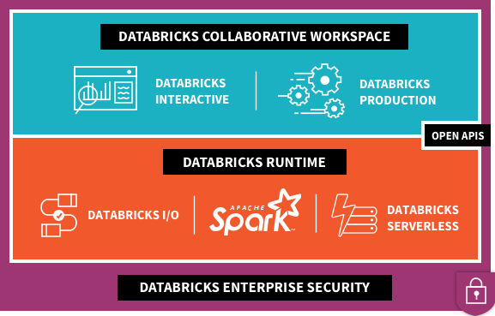


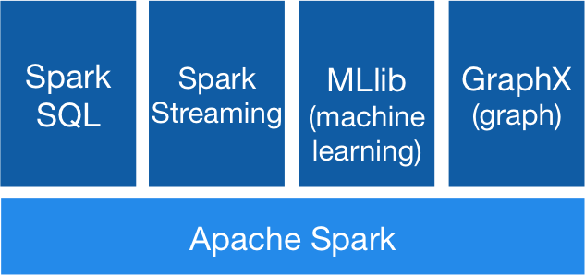



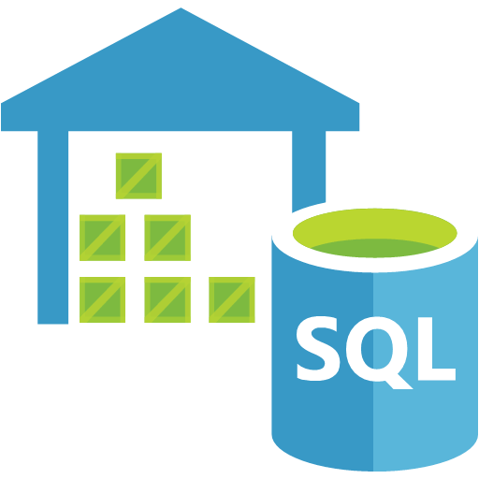
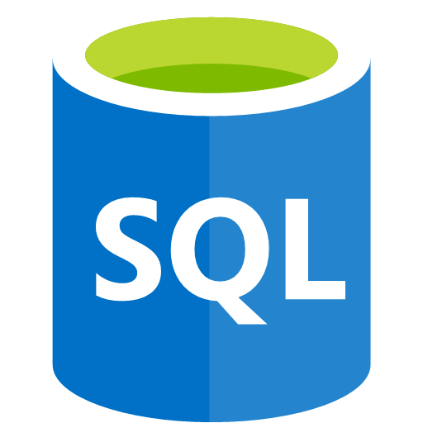




What’s Under the Hood?
2
1
Data Factory
Power BI
3
Data Lake
Store
Blob
Storage
SQL Data
Warehouse
SQL DB
Cosmos DB
Event Hubs
Kafka
On HDInsight

Slide 33
What’s Under the Hood?
Data Factory
Power BI
Data Lake
Store
Blob
Storage
SQL Data
Warehouse
SQL DB
Cosmos DB
Event Hubs
Kafka
On HDInsight

Slide 34



Azure Databricks key audiences & benefits
Data scientist
Data engineer
CDO, VP of analytics
Integrated workspace
Easy data exploration
Collaborative experience
Interactive dashboards
Faster insights
Best Spark & serverless
Databricks managed Spark
Improved ETL performance
Zero management clusters, serverless
Easy to schedule jobs
Automated workflows
Enhanced monitoring & troubleshooting
Automated alerts & easy access to logs
Zero Management Spark
Cluster democratization (High-concurrency)
Fast, collaborative analytics platform accelerating time to market
No dev-ops required
Enterprise grade security
Encryption
End-to-end auditing
Role-based control
Compliance
Unified analytics platform
Provided by Microsoft and Databricks under NDA

Slide 35
eastus2.azuredatabricks.net

Slide 36

Azure Databricks
Azure Databricks
Collaborative Workspace
IoT / streaming data
Machine learning models
DATA ENGINEER
DATA SCIENTIST
BUSINESS ANALYST
Deploy Production Jobs & Workflows
Cloud storage
BI tools
MULTI-STAGE PIPELINES
JOB SCHEDULER
NOTIFICATION & LOGS
Data warehouses
Optimized Databricks Runtime Engine
Data exports
Hadoop storage
DATABRICKS I/O
APACHE SPARK
HIGH-CONCURRENCY
Rest APIs
Data warehouses
Enhance Productivity
Build on secure & trusted cloud
Scale without limits
Notes:
Databricks, founded by the team that created Apache Spark – unified analytics platform that accelerates innovation by unifying data science, engineering & business.
75% of the code committed to Apache Spark comes from Databricks
Unified Runtime
Create clusters in seconds, dynamically scale them up and down.
They’ve made enhancements to Spark engine to make it 10x faster than open source Spark
Serverless- Auto-configured multi-user cluster, Reliable sharing with fault isolation
Unified Collaboration
Overall – a simple & collaborative environment that enables your entire team to use Spark & interact with your data simultaneously
DE – Improve ETL performance, zero management clusters. Execute production code from within notebooks
DS - For data scientists, easy data exploration in notebooks
Business SME – interactive dashboards empower teams to create dynamic reports
Enterprise Security
Encryption
Fine grained Role-based access control (files, clusters, code, application, dashboard)
Compliance
Rest APIs
DE – DBIO, SPARK, API’s , JOBS
DS – Spark and Serverless, Interactive Data Science
Data Products - Everything
Creators of Spark
Training People
Number of Customers
Ingest
Workflow
Schedule / Run / Monitor
Execute
Troubleshoot
Debug
Production Jobs
---------
Ingest, ETL, Scheduling, Monitoring

Slide 37
Spark is Lazy, but in a Smart Way
Transformations
Lazily evaluated.
Actions
Not lazily evaluated.
Multiple transformations add to the steps of a Spark job, but no data gets processed.
Spark operation that returns a DataFrame (usually).
Returns counts of elements or lists of them (usually)
Examples: show/display, count, collect, take, write
Examples: select, filter, groupBy, map
Enacts a series of transformations
When you execute a command, Spark doesn’t actually do anything unless it’s required to show you something or it has to write something out.
This is the difference between a Transformation and an Action.
“Lazy Evaluation”

Slide 38
Spark Pipelines
Can be saved similar to ML models
Provides stability into the model scoring process
Dummy code categorical features
[OneHotEncoder]
Assemble data into a series of vectors
[VectorAssembler]
Scale features [StandardScaler]
Prepare pipeline
[pipeline.fit(dataset)]
Transform data through pipeline
[pipelinemodel.
transform(dataset)]
Define which columns are categorical and numerical

Slide 39
MLlib Models
Define parameter grid
[ParamGridBuilder]
Define evaluation method
[BinaryClassification
Evaluator]
Define cross-validation method
[CrossValidator]
Fit model
[cv.fit(train)]
Transform data through model
[cvModel.transform(test)]
Initialize ML algorithm object
[LogisticRegression]
Evaluate model
[evaluator.
evaluate(predictions)]

Slide 40
Lab Steps - Databricks
Grab a dataset and put it in the class data lake
Mount your data lake in your group’s cluster
Data Prep
Save your pipeline to the data lake
Split data into train/test
Machine Learning
Data Lake Stuff
Preprocess your data to vectorize it
Create a simple ML model using Spark Mllib
Evaluate the model
Write the model to the data lake

Slide 41
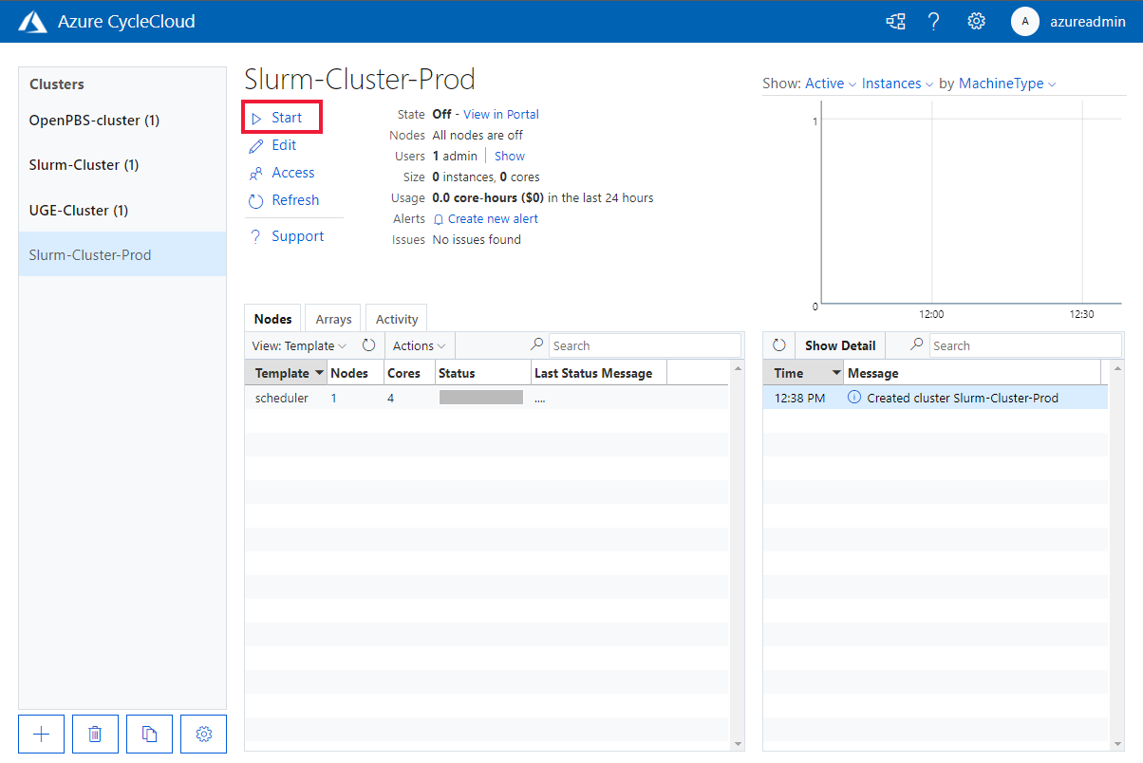


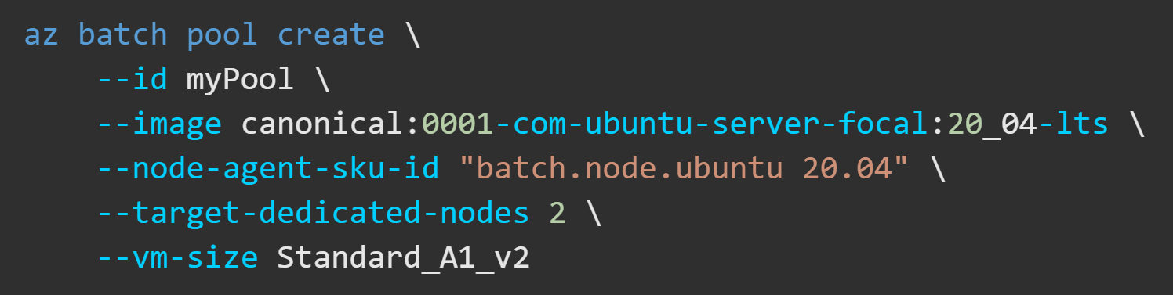
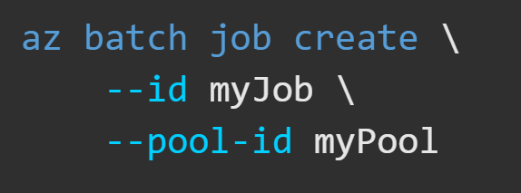
Other HPC Services
Azure Batch
Dynamically scale to 1,000s of VMs
Operates in pools with VM sizes, container images, # nodes, etc.
Operates on “job tasks”
Azure CycleCloud
Closest to an on-prem HPC cluster
Operates “templates” that define VM types, # nodes
Uses various schedulers like SLURM, PBS, etc.
H- and N-Series VMs
Fancy/Many Processors
Xeon Platium 8000 Series CPUs
Largest: 832 vCPUs
High memory bandwidth
350GB/sec + InfiniBand
Large memory capacity
10TB+ of Memory
Multiple Fancy GPUs
8 x H100 94GB GPUs
High Network I/O
40,000 Mbps
https://learn.microsoft.com/en-us/azure/high-performance-computing/

Slide 42
HPC Use Cases
Azure Limits:
Azure Kubernetes Service:
5,000 nodes
100 clusters/region
1,000 nodes/pool
100 pools/cluster
Azure Batch:
2,000 nodes
1,000 active jobs
900-ish cores
500 pools/account
Azure CycleCloud:
Max MPI Job: 36,000 Cores
Overall:
25,000 VMs/region
75,000-ish cores/region
On-Premise Examples:
UNCC HPC: https://oneit.charlotte.edu/urc/research-clusters/
MIT Super Cloud: https://mit-supercloud.github.io/supercloud-docs/systems-and-software/
3D Video Rendering
Genomics
Physics Simulations
Financial Simulations
Large In-Memory Databases
CAD/ Engineering
Molecular Modeling
Distributed AI Training
Geospatial/ Weather Modeling

Slide 43
Sample Architectures
https://learn.microsoft.com/en-us/azure/architecture/browse/

Slide 44






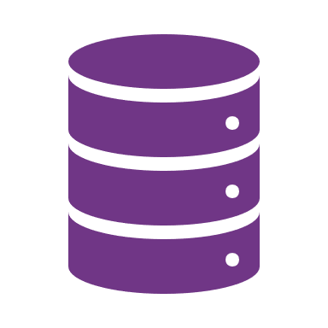













30k Foot View - Architecture
Source
Ingest
Transform
Query and Process
Serve
Output
Data Governance
Data Workﬂows
Orchestration
Git, CI/CD
MLOps Stacks
Devices/ IoMT
Data Science and ML
Model Serving
Experiments,
AutoML,
Model Mgmt.
Serverless,
Real-Time Inferencing
Event Streaming
Lakehouse
Platform
Feature Store
Databases /
EHR Systems
Apps
Data Engineering / Engines
Data Warehouse
Operational
Database
Lab Results
Delta Live Tables
Auto Loader
Transform, Cleanse, Prepare
Azure
Synapse
AWS Redshift
Databricks
Snowflake
BI Tools /
Dashboards
Images
Data Sharing
20
Ingestion tool
Cloud Storage /
Data Lake
Delta Sharing
3rd Parties
-omics
Text Data / Notes

Slide 45

Big Data & Advanced Analytics at a glance
Ingest
Store
Prep & Train
Model & Serve
Intelligence
Business apps
Data Factory
(Data movement, pipelines & orchestration)
Cosmos DB
DSVM
Databricks
HDInsight
Data Lake Analytics
Predictive apps
Kafka
10 01
Blobs
Data Lake
SQL
SQL Database
Custom apps
SQL Data Warehouse
Operational reports
Event Hub
IoT Hub
Machine Learning
Sensors and devices
Analysis Services
Analytical dashboards
Notes:
Azure build-out of DMSA. Supports hybrid\on-premises too through ADF \ Blob \ Stretch.

Slide 46
Modern Big Data Warehouse
Ingest
Store
Prep & Train
Model & Serve
Intelligence
Logs, files and media (unstructured)
Data factory
Azure storage
Azure Databricks
(Spark)
Business / custom apps
(Structured)
Polybase
Data factory
Azure SQL Data Warehouse
Analytical dashboards

Slide 47
Advanced Analytics on Big Data
Ingest
Store
Prep & Train
Model & Serve
Intelligence
Logs, files and media (unstructured)
Data factory
Azure storage
Azure Databricks
(Spark MLlib, SparkR, sparklyr)
Azure Cosmos DB
Web & mobile apps
Business / custom apps
(Structured)
Polybase
Data factory
Azure SQL Data Warehouse
Analytical dashboards

Slide 48






Modern Data Platform with Azure Databricks
Ingest
Store
Prep and train
Serve
Model Serving
Azure Machine Learning service
Azure Kubernetes service
Azure Event Hubs
Streaming data
Operational Databases
Apps
Cosmos DB, SQL DB
Azure Databricks
Ad-hoc Analysis
Power BI
Batch data
Azure analysis services
Azure Data Factory
Azure Data Lake Storage
Azure SQL data warehouse

Slide 49
Modern Big Data Warehouse
Ingest
Store
Prep & Train
Model & Serve
Intelligence
Logs, files and media (unstructured)
Data factory
Azure storage
Azure Databricks
(Spark)
Business / custom apps
(Structured)
Polybase
Data factory
Azure SQL Data Warehouse
Analytical dashboards

Slide 50
Real-time analytics on Big Data
Ingest
Store
Prep & Train
Model & Serve
Intelligence
Unstructured data
Azure HDInsight (Kafka)
Azure Databricks
(Spark)
Polybase
Azure storage
Azure SQL Data Warehouse
Analytical dashboards

Slide 51
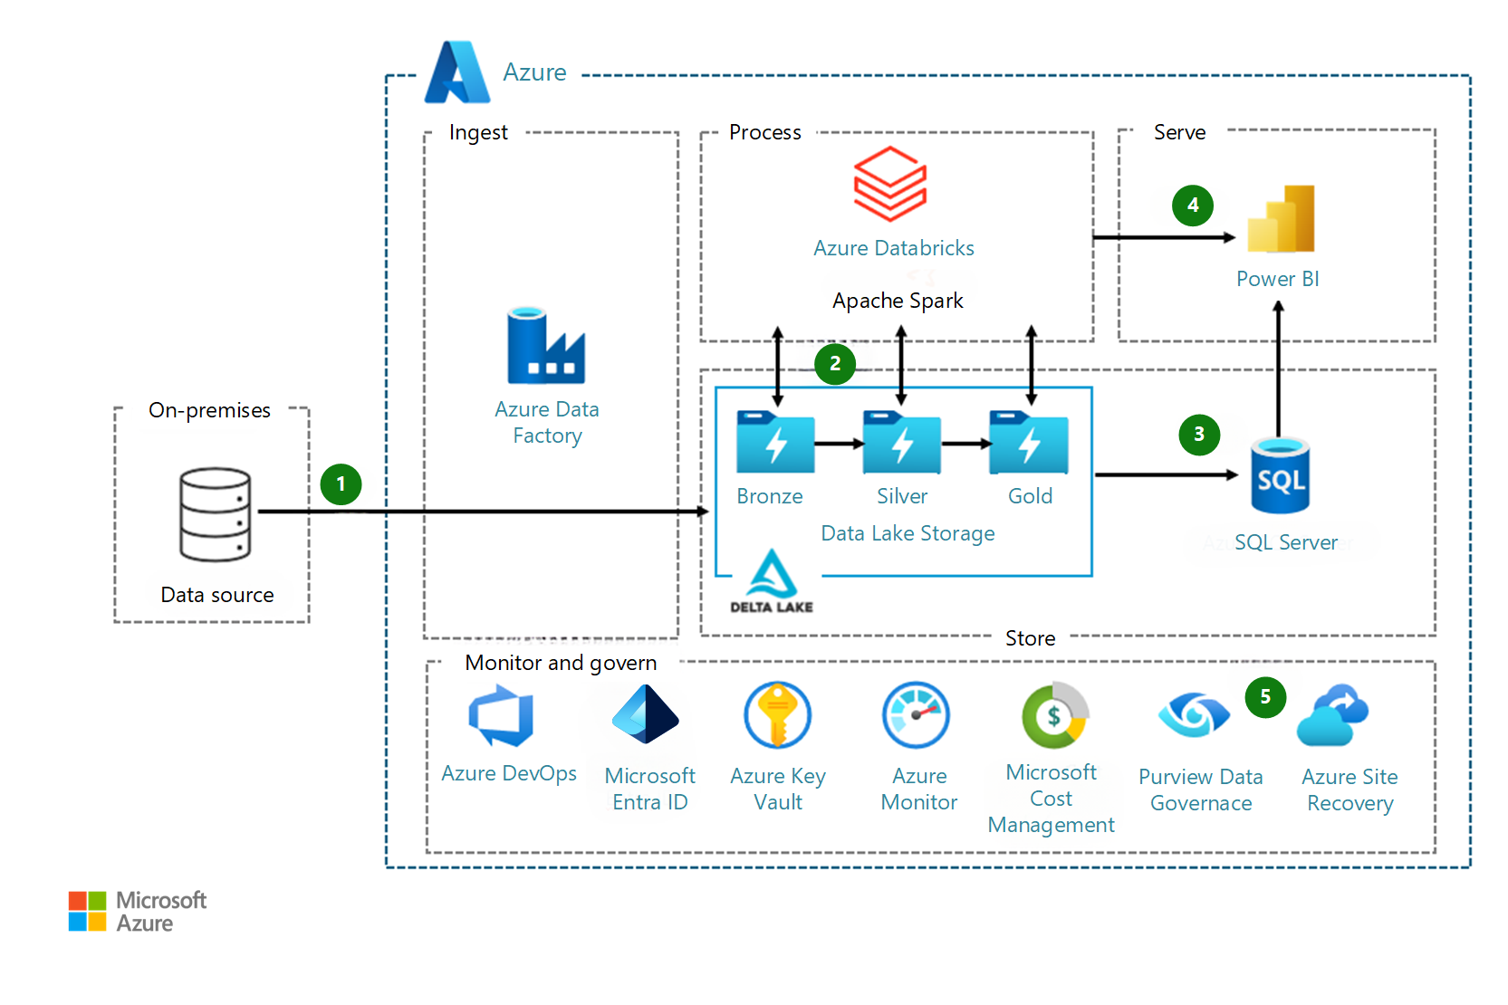
Data Factory + Data Lake

Slide 52
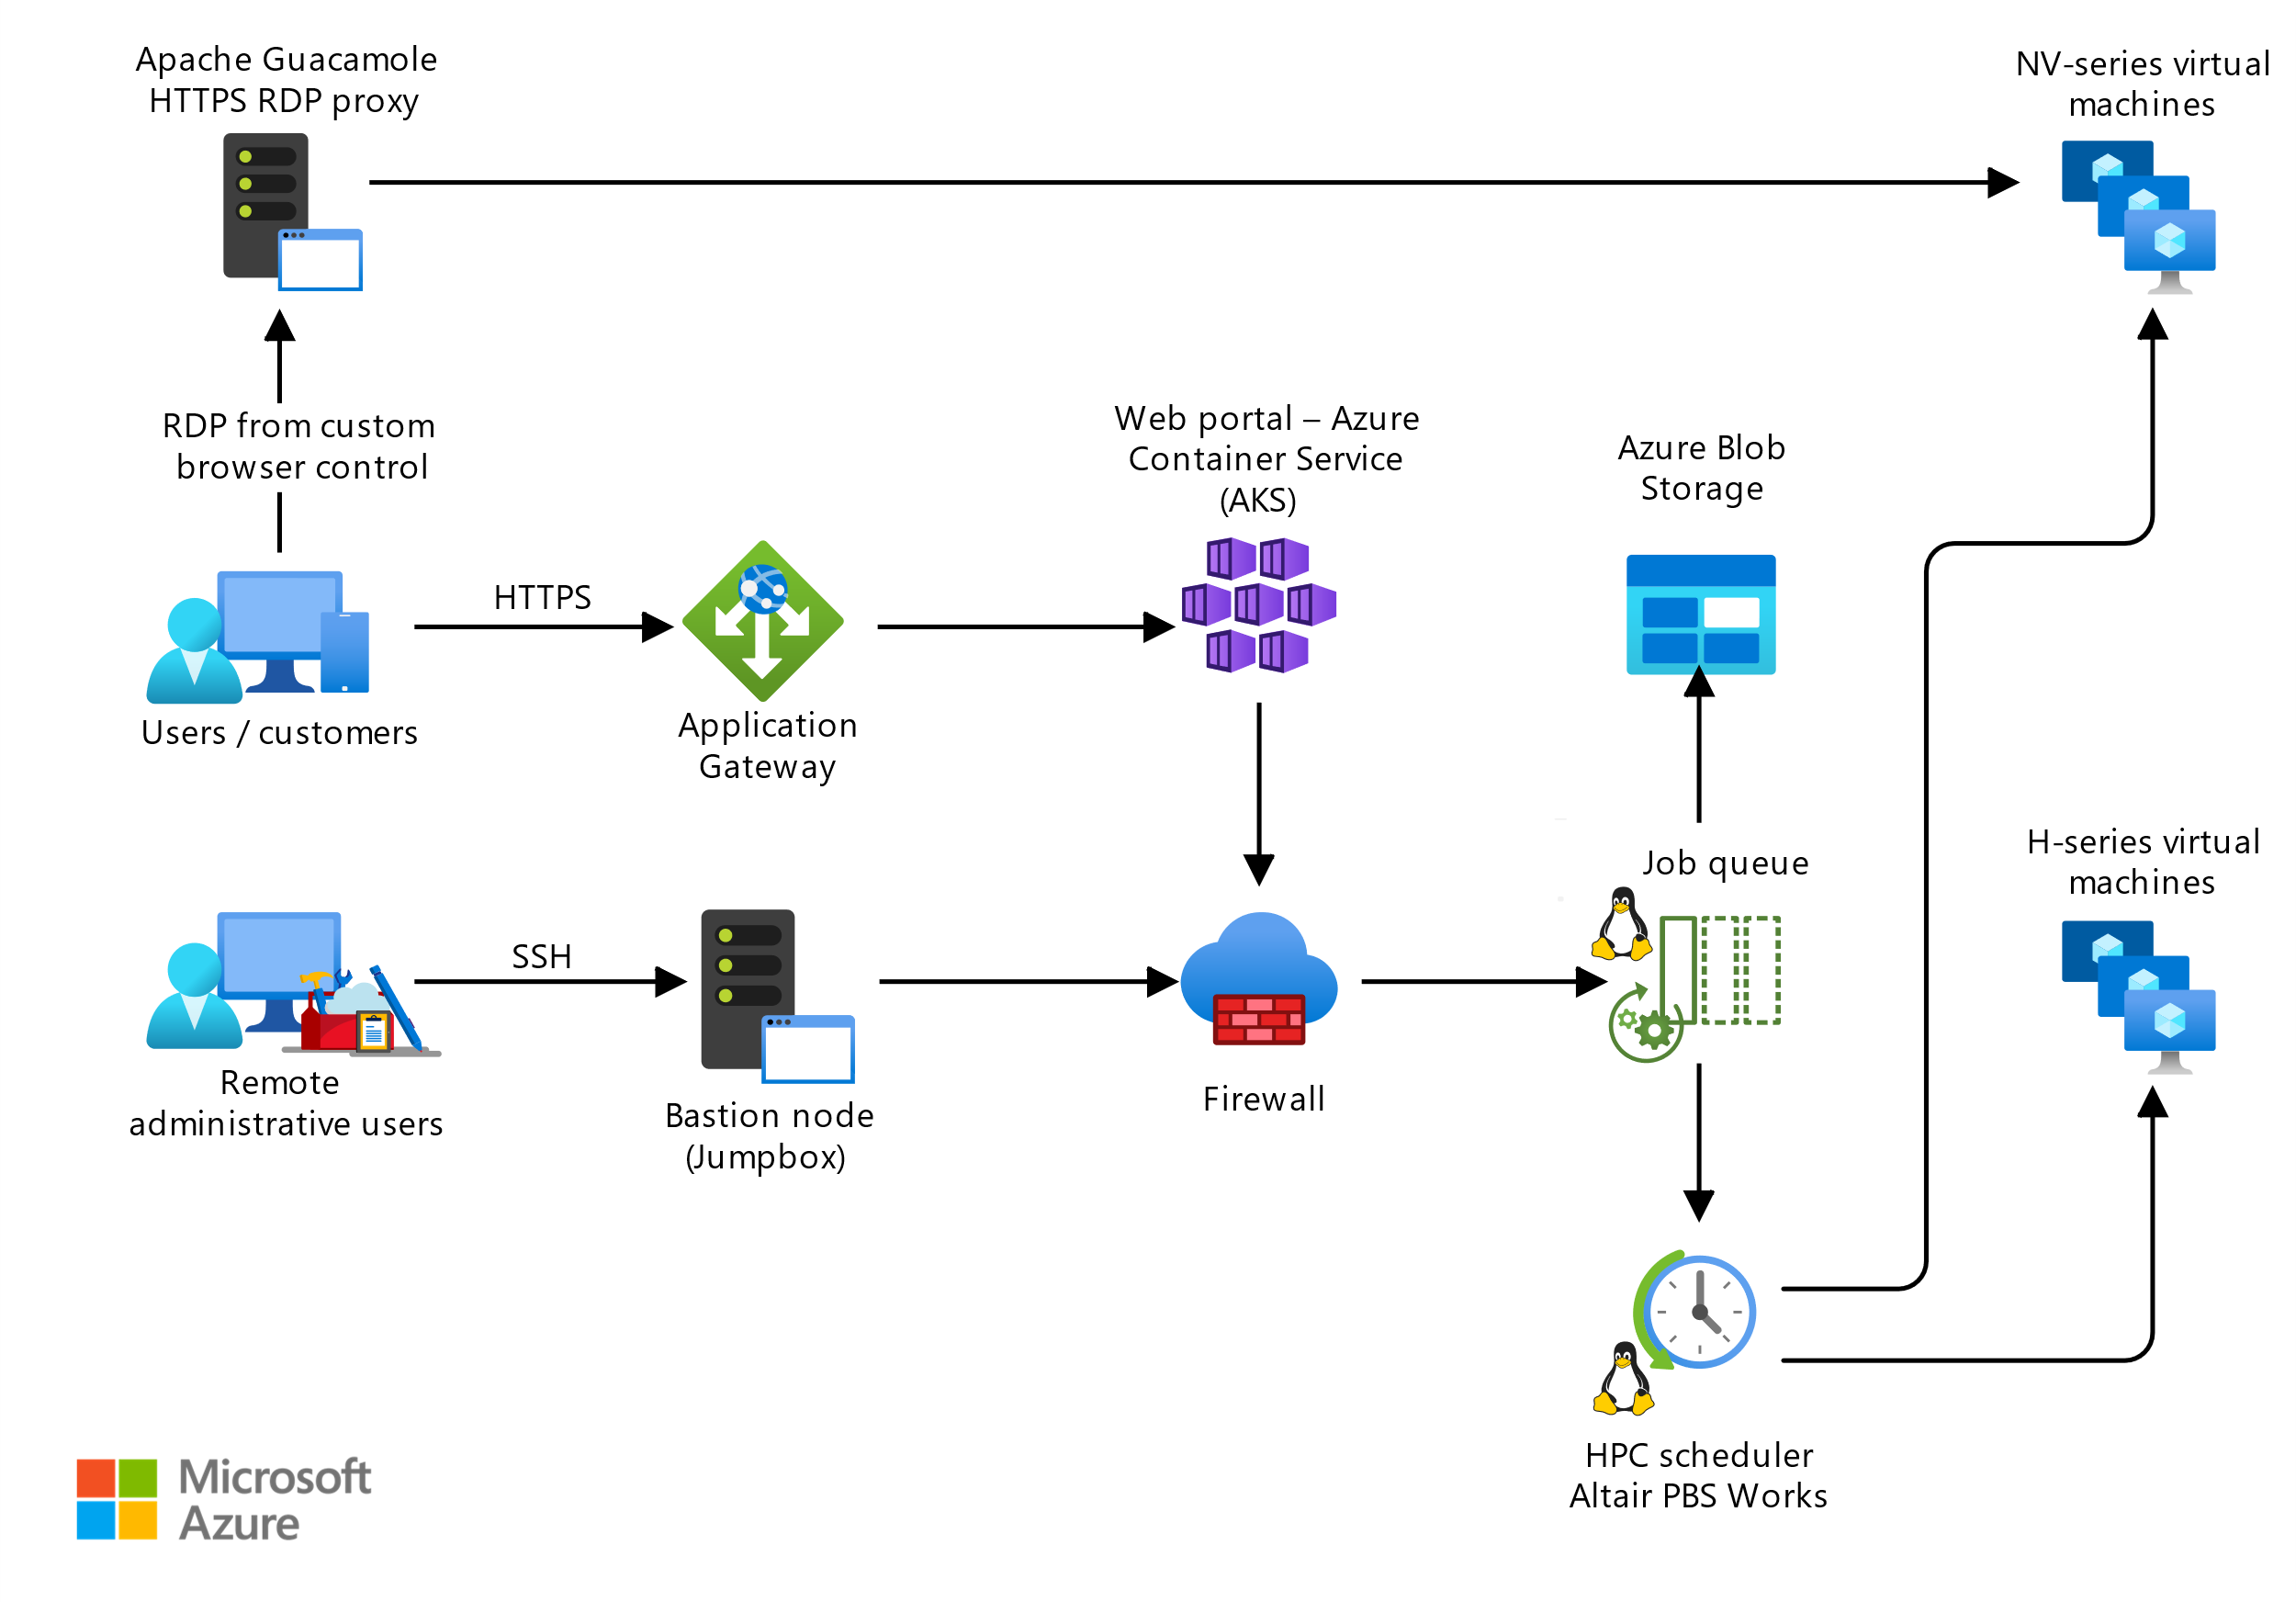
Computer-Aided Engineering

